Slide 1
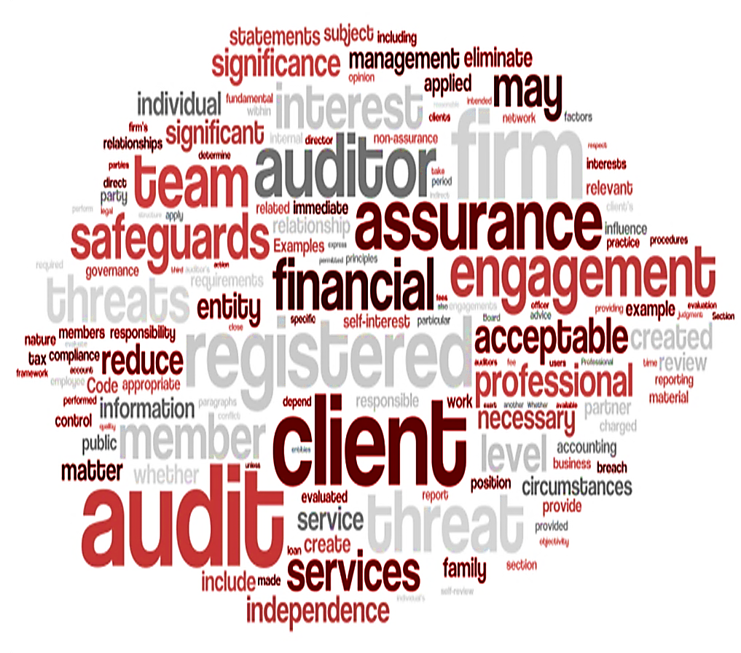
ETHICS WORKSHOPS 2014

Slide 2
Programme
Introduction
IRBA update
Session 1: Discussion led by Uli Schäckermann
Tea
Session 2: Discussion led by Saadiya Adam
Session 3: Discussion led by Uli Schäckermann
Recap and Conclusion
Ethics – unravelling a
registered auditor’s
responsibilities

Slide 3
IRBA Update: ROSC 2013 IRBA Strategy Major Audit Developments The Audit Development Programme
Ethics – unravelling a
registered auditor’s
responsibilities

Slide 4
IRBA Strategy
Transformation
Leadership in Africa
Independence
Super - regulator

Slide 5
Major Audit Developments
Auditor reporting
Integrated reporting
Pronounce-ments
New ISA 701: Key audit matters – listed companies
Publication of <IR> framework
Discussion paper on assurance
Adoption trends in South Africa and abroad
Attorneys Trust Account Audit Guide – issued March 2014
Medical Schemes Audit Guide – exposure draft to be issued Nov 2014
Reportable Irregularities Guide – exposure draft 2015
ISA 700 series: Comment on management’s use of going concern, comment on material inconsistencies with other information, opinion first and other re-ordering, likely December 2016 year-ends

Slide 6
The Audit Development Programme
ADP
Effective:
1 January 2015
Who may offer
Who may join
Requirements
For question on the ADP contact rzwane@irba.co.za

Slide 7
Session 1: The Fundamental Principles and Threats to Compliance Safeguards Purpose of Safeguards Integrity and Keeping a Promise Marketing, communication and Social Media Independence Reasonable and Informed Third Party (RITP)
Ethics – unravelling a
registered auditor’s
responsibilities

Slide 8
Fundamental Principles and Threats to Compliance
Integrity
Objectivity
Professional Knowledge and due care
Confidentiality
Professional Behaviour
Safeguards
Threats to Compliance
5 Fundamental Principles
Self Interest Threat
Self Review Threat
Advocacy Threat
Familiarity Threat
Intimidation Threat

Slide 9
Safeguards
Paragraph 100.13-100.16
Safeguards by the profession, legislation/regulation:
Educational, training and experience required to enter profession
CPD
Corporate governance, legislation and regulations
Professional standards
Professional monitoring and disciplinary procedures
External review of work done by RA

Slide 10
Purpose of Safeguards
Steps to be taken when a threat is identified
Evaluate significance
Take qualitative and quantitative action
Objective must be
Threats have been eliminated
Threats have been reduced to an acceptable level (judgement)
Objective not achieved
Decline
Discontinue
Resign
Ethics – unravelling a
registered auditor’s
responsibilities

Slide 11
Integrity and Keeping a Promise
The Code gives additional information:
be straightforward and honest
do not publish information that:
is materially false or misleading;
is furnished recklessly; or
omits or obscures.
Some examples of where keeping promise is important:
"The audit will be completed by xxx”
"The cost of the audit will be xxx”
"Staff are our most important asset"

Slide 12
Marketing, Communication and Social Media
The profession makes full use of these types of media in promoting its services and informing clients and potential clients about their capabilities and offerings.
Rule 2.17 of the Rules Regarding Improper Conduct is of importance.
Paragraphs 250 of the Code of Conduct is relevant:

Slide 13
Independence (1)
Independence relates to assurance engagements
About ¾ of the code deals with independence arising from various audit failures
Major concern for:
The public
The regulator
Law makers – Companies Act Section 90(2)
Independence is threatened when one or more of the five threats are identified

Slide 14
Independence (2)
When does the RA need to assess independence?:
At client acceptance stage (ISQC1)
At planning stage
- Independence throughout the period covered by the AFS
During the audit
At the time of signing the report

Slide 15
Independence (3)
What needs to be assessed?:
Personal relationships
Engagement professionals
Partners
Firm and network firms
Business relationships
Financial interest
Loans guarantees
Non-assurance services
Ethics – unravelling a
registered auditor’s
responsibilities

Slide 16
Independence (4) Case Study: Family Relationships
Scenarios:
Mr. Vega Snr is invited to become the group auditor.
Mrs.Vega is an independent non-executive director of FHL, or
Mr. Vega Jnr, son of Mr. Vega, is the Financial Director of Distributor, or
Miss Vega, daughter of Mr. Vega, is in a relationship with the Production Director of Manufacturing, or
A nephew of Mr. Vega is the Financial Director of FHL and Mr ABC , a close friend of Mr Vega Snr, is the Human Resources Director at FHL.
Can Mr. Vega be the group auditor in each
of these scenarios?
Family Holdings Limited
Manufacturing (Pty) Ltd – 80%
Distributor (Pty) Ltd – 35%

Slide 17
Independence (5) Case Study: Conflict of Interest
An auditing firm, Eagle Auditing (EA), has been engaged to audit the annual financial statements of Sun Power Limited (SPL), listed on the JSE. EA is located in Johannesburg and has associated offices in Durban and Cape Town, which are engaged in the audit of the subsidiaries of SPL in those locations. The audit is headed by a partner from the Johannesburg office.
The Cape Town office has a direct shareholding in SPL (8%)
A director of the Durban office holds 100 shares in SPL
What threats arise?
Are there any safeguards?
Using the Decision Making Matrix
Attachment 2

Slide 18
Independence (6) Documentation Layout
See the attachment 3 in the slide pack
Ethics – unravelling a
registered auditor’s
responsibilities

Slide 19
The Reasonable and Informed Third Party (RITP)
The RITP is found in 13 places in the Code
Relates to decisions that have been made
Conceptual Framework
Independence
Who is an RITP?
Use the above mentioned tools in your working papers.
How does that person make a decision? – think of EQRP.
“Weighing up all the specific facts and circumstances available to the registered auditor at the time, would be likely to conclude that the threats would be eliminated or reduced to an acceptable level by the application of the safeguards” (200.10)

Slide 20
The RITP – a Case Study
Attachment 4 in the slide pack
During the course of an audit, the audit manager – not yet a registered auditor – began a personal relationship with the financial director of the audit client. The audit continued for another three weeks. One of the trainees on the audit team reported this to the engagement partner, as he was somewhat concerned.
The partner listened to the trainee and asked some questions, then, having spoken to the audit manager, decided that the matter was not serious enough to receive further attention. The audit was already a bit late and budget overruns were likely.
The audit was then completed and the audit report issued. About three months later an instance of fraud was discovered by the client that had resulted in revenue being significantly overstated. Further investigation revealed that the working papers underlying the audit of revenue did not indicate a problem with revenue recognition.
The client was then informed about the relationship between the audit manager and the financial director. The engagement partner denied any responsibility as he had not been aware of any independence issue relating to this audit.
The RITP is called in. What would she do?

Slide 21
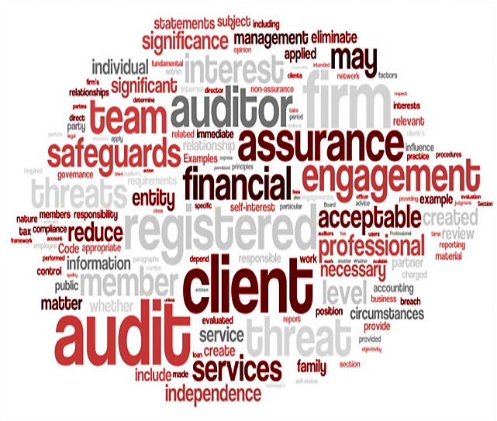
Session 2: Amendments to the IRBA Code Expected Development The Code and Legislation
Ethics – unravelling a
registered auditor’s
responsibilities

Slide 22
Amendments to the IRBA Code
Amendments to the Code became effective from 1 April 2014
Response to changes in the IESBA Code
Ethics – unravelling a
registered auditor’s
responsibilities
Alignment with ISAs
Conflicts of Interest
Inadvertent violations
Breaches of a requirement of the Code

Slide 23
Amendments to the IRBA Code (2)
Definition section – engagement team, those charged with governance
Paragraph 100.10 – replacement, inadvertent violation
Paragraphs 100.17-100.22 – renumbered 100.19-100.24
Paragraphs 100.17-100.18 – inserted, conflicts of interest
Paragraph 100.25 - inserted, those charged with governance
Section 220 – conflicts of interest
Paragraph 290.28 – those charged with governance
Paragraphs 290.39-290.49 – inadvertent violations
Paragraphs 290.117, 290.135, 280.159 – deleted

Slide 24
Expected Developments
IRBA Code¹
New IESBA Handbook²
Long Association of Personnel (Including Partner Rotation) with an Audit Client
Structure of the Code – usability, applicability, enforcement. Culture not translation.
Review of Part C of the Code.
Non-Assurance Services.
Responding to Non-Compliance with Laws and Regulations.
¹http://www.irba.co.za/dmdocuments/Rules%20and%20IRBA%20Code%20(Revised%202014)%20Issued%2017%20March%202014.pdf
²www.ifac.org/publications-resources/2014-handbook-code-ethics-professional-accountants

Slide 25
The Code and Legislation (1)
Section 90 of the Companies Act, 2008
It is the law (Not a Code Issue)
Applicable to audit engagements of:
Companies and CCs requiring an Audit in terms of the Act or
An Audit voluntarily required by the MOI
IRBA have been monitoring compliance from 1 January 2014
Notes:
Why does section 90(2) actually exist?
Standard setters and regulators the world-over are concerned about independence.
IFAC
PCAOB
European Commission
IRBA
SA Legislators
more

Slide 26
The Code and Legislation (2)
Section 92 of the Companies Act prohibits the individual auditor from serving as the auditor of a company for more than five consecutive financial years.
Paragraph 290.151 of the IRBA Code states that an individual shall not be the key audit partner for more than seven years.

Slide 27
The Code and Legislation (3)
Effects of not complying with the Companies Act
Companies Act
Contravention of an Act
Contravention of the IRBA Rules Regarding Improper Conduct
Rule no 2.2
Contravention of the IRBA Code of Conduct
Non compliance with the fundamental principles

Slide 28
Session 3: Firm and Network Firms Professional Fees Audit Fees and Independence
Ethics – unravelling a
registered auditor’s
responsibilities

Slide 29
Firm and Network Firms (1)
Definition of firm:
A partnership, company or sole proprietor referred to in Section 38 of the Auditing Profession Act;
Definition of network:
An entity that controls the parties in (a), through ownership, management or other means; and
An entity controlled by the parties in (a), through ownership, management or other means.
A larger structure:
That is aimed at co-operation; and
That is clearly aimed at profit or cost sharing or shares common ownership, control or management, common quality control policies and procedures, common business strategy, the use of a common brand-name, or a significant part of professional resources.

Slide 30
Firm and Network Firms (2)
The consequence of being a network is that all firms in the network must be independent of audit clients of other firms within that network.
Network firm:
Part of a larger structure that shares:
a common brand name; or
a common system of quality control; or
significant professional resources; or
profit and loss; or
costs; or
common ownership, control or management; or
common business strategy

Slide 31
Firm and Network Firms (3) Case Study
Case study has been included in the pack. ( Attachment 5)
Ethics – unravelling a
registered auditor’s
responsibilities

Slide 32
Firm and Network Firms (4)
The decision of whether a network exists must be made by each firm. It is judgement-based and documentation is required regarding the decision taken.
The decision will always be subject to review by a RITP.
The consequence of being a network is that all firms in the network must be independent of audit clients of other firms within that network.

Slide 33
Professional Fees (1) Section 240
Quote an appropriate fee – too low, too high
Identify the exact services
Make clients aware of the terms of engagement
Budget sufficient time and allocate appropriate staff
Contingent fees for non-assurance assignments create a self-interest threat to objectivity:
What does the significance depend on?
What are the available safeguards?
Contingent fees for assurance services are prohibited under S240.4A

Slide 34
Professional Fees (2) Section 240
Referral fees received from client
Referral fees paid by RA
What fundamental principles can be affected?
What threats can be identified?
What safeguards can be recommended?
Purchase of firm and payment made to heirs of the estate
Ethics – unravelling a
registered auditor’s
responsibilities

Slide 35
Audit Fees and Independence (1) Case Study
Please see attachment 6 for case study
Ethics – unravelling a
registered auditor’s
responsibilities

Slide 36
Audit Fees and Independence (2) 290.217-290.224
Fees – relative size
The firm receives a large proportion of fees from a single client.
Large portion of the revenue from a single partner or an individual office.
Safeguards may include:
Reduce dependency on that client
Review of work done
Quality review of the engagement

Slide 37
Audit Fees and Independence (3) 290.217-290.224
Fees – relative size – PIEs
Fee exceeding more than 15% of total fees in 2 consecutive years (from the client and related entities):
Discuss with those charged with governance
Either use pre-issuance review or post issuance review:
if significantly in excess of 15%, pre-issuance review compulsory.

Slide 38
Audit Fees and Independence (4) 290.217-290.224
Overdue fees
Self-interest threat to independence is created
Significant part of prior year fees must be paid before the next audit report is issued, if not:
Evaluate threat and apply safeguards.
If fees deemed to be a loan, consider reappointment

Slide 39
RECAP

Slide 40
Contact Details
IRBA Standards Department:
087 940 8800
standards@irba.co.za
www.irba.co.za
Mr. Uli Schäckermann:
082 554 1243
consultus@schackermann.eu
Ethics – unravelling a
registered auditor’s
responsibilities

