Slide 1

Presenters:
Imre Nagy, Pieter Cloete
& Sadhir Issirinarain
Root Cause Analysis (RCA)
Information Session
27 June 2017

Slide 2

RCA Information Session
Index Statistics The need for RCA Policy The IRBA Remediation Process RCA Introduction & Background Principles of RCA Questions Case Studies Contact

Slide 3

Statistics
International Financial Reporting Council (FRC) “We expect all the firms we inspect to make continuous improvements such that, by 2019, at least 90% of FTSE 350 audits reviewed will be assessed as requiring no more than limited improvements.” Effective RCA should help to achieve this. International Forum of Independent Audit Regulators (IFIAR) Although the 2016 report showed only 1% improvement from 2015 on engagements with at least 1 finding, IFIAR’s Global Audit Quality (GAQ) Working Group and the GPPC networks undertook an initiative aimed to reduce the frequency of inspection findings by at least 25%, on an aggregate basis across the GPPC networks over four years through RCA.

Slide 4


Statistics (cont …)
Local The IRBA aims to promote a notable reduction in inspection findings through its Remedial Action Process (RAP) with the firms. The IRBA has actively engaged with 136 (72%) auditors that received an unsatisfactory inspection result in the 2016 year (2016 Public Inspections Report). The IRBA has actively engaged with 55 auditors that received an unsatisfactory inspection result in the past six months. 23 of the 55 (42%) did not identify the true root cause or possible causes were too vague. 8 of the 55 (15%) did not implement an appropriate action plan to address root causes. However, since the introduction of the remedial action process by the IRBA 2,5 years ago, approximately 80% of recent re-inspections received a satisfactory result, which is encouraging.

Slide 5

The Need for RCA
There is a significant misunderstanding of the RCA and in many instances it would either be incorrectly prepared or not prepared at all. Identifying, for example, “lack of documentation” as the root cause without getting to the real answer as to WHY the documentation was deficient is not enough. As per the 2016 IRBA Public Inspections report, the highest root cause allocation was “human error”, without drilling down to exactly WHY the issue existed or resulted in a finding (root cause vs. symptoms). Those auditors that effectively identified the underlying root causes and implemented real proactive action plans demonstrated significant improvement during follow-up inspections.

Slide 6
Policy Reference Policy In its efforts to promote high audit quality, the IRBA adopted the IFIAR Core Principle 11, which states that audit regulators should have a mechanism for reporting inspections findings to the audit firm and ensuring remediation of findings with the audit firm. ISQC 1 para 50: “The firm shall communicate to relevant engagement partners and other appropriate personnel deficiencies noted as a result of the monitoring process and recommendations for appropriate remedial action.” (Ref: Para. A69) ISA 220 A33: “In considering deficiencies that may affect the audit engagement, the engagement partner may have regard to measures the firm took to rectify the situation that the engagement partner considers are sufficient in the context of that audit.”

Slide 7

Policy Reference (cont …)
Current IAASB agenda (WIP project) on enhancing audit quality: “We are seeking to understand what our stakeholders think about the ‘root causes’ of these inspection findings.” (Refer to the IAASB website)
Proposed revision to ISQC 1: For example, include remediation as a header as well as refer to internal and external monitoring findings.
Determine the cause(s) of deficiencies and evaluate their effect and implement appropriate remedial action(s).
International buzz word: Professional Scepticism
(same principle can be applied in conjunction with RCA!)
  Professional scepticism means an attitude that
  includes a questioning mind; being alert to
  conditions that may indicate possible misstatement
  due to error or fraud; and a critical assessment of evidence.

Slide 8
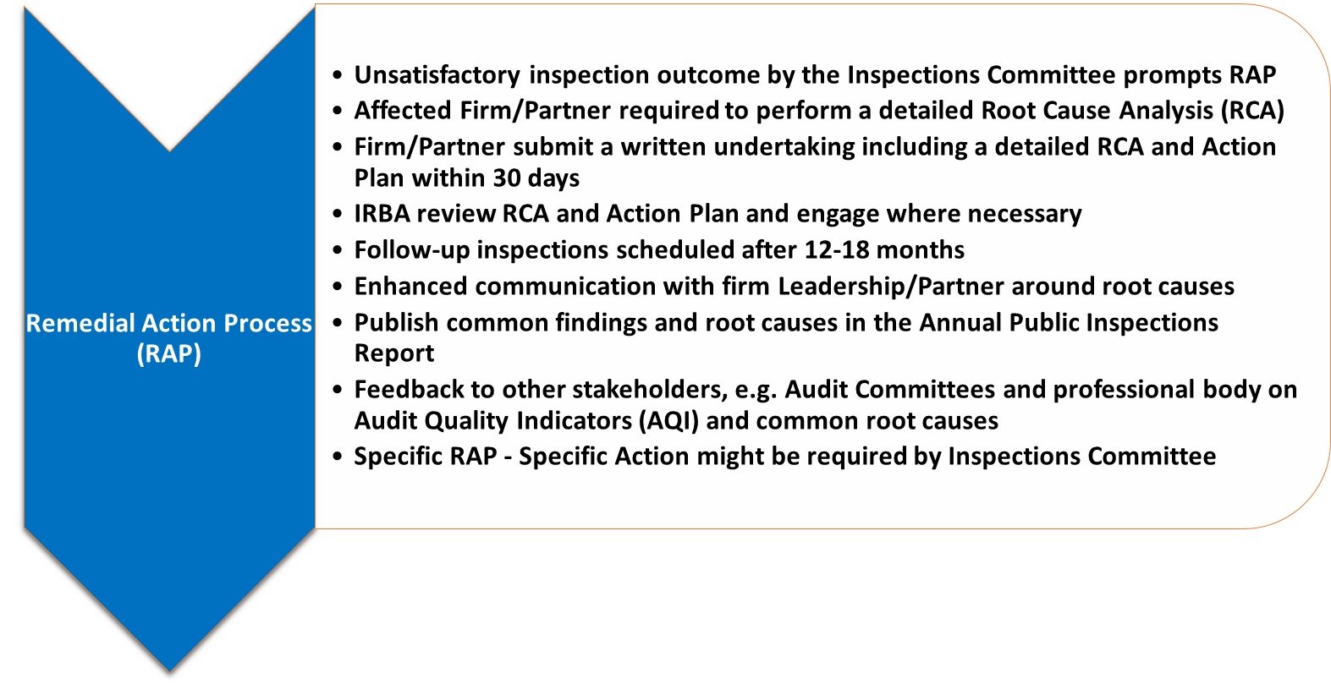
The IRBA Remediation Process
South African Approach – Remedial Action Process (RAP)

Slide 9
The IRBA Remediation Process
(cont …)
Please note: The IRBA will visit all unsatisfactory/investigation referral inspection results for engagements and firms. Request further documentation and/or evidence that the condition/s was met for conditional satisfactory results. (Conditional results can be motivated where there are only a few findings not impacting materially on the audit report and not significant risk or public interest in nature.) The evidence is reviewed and assessed on whether the condition/s was met, and these practitioners are also visited where deemed necessary. If the condition/s is not met, the file is referred back to the Inspections Committee for reconsideration. The sole objective is to prompt remedial action by the firm on all of its audits.

Slide 10

RCA Introduction & Background
Sources Local: IRBA Remedial Action Process (RAP) feedback 2016 Public Inspections Report (refer to the IRBA website) IRBA Internal Policy and Procedure (not public) International: IFIAR Inspection Survey Report (www.ifiar.org) FRC audit quality thematic review report (www.frc.org.uk) ICAEW report on “Improving audit quality using root cause analysis” (www.icaew.com)

Slide 11
RCA Introduction & Background
(cont …)
Brief history on RCA:
Developed by Sakichi Toyoda who later founded Toyota Motor Company.
RCA was first used during the development of Toyota’s manufacturing processes in 1958.
Definitions:
Root Cause: The original event, action and/or condition generating an actual or potential undesirable condition, situation, nonconformity or failure.
RCA is a technique for identifying the underlying key cause (or causes) behind review findings, whether specific to one audit or firm wide, so that an appropriate and achievable action (or actions) can be taken to prevent the recurrence of negative outcomes and promote the recurrence of positive ones.

Slide 12
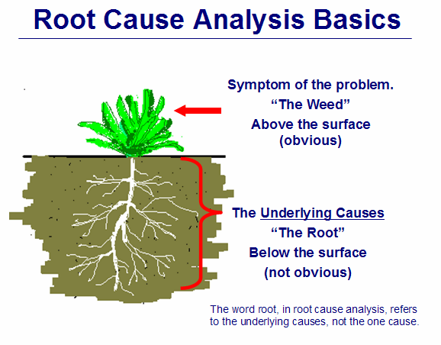
RCA Introduction & Background (cont …)

Slide 13

RCA Introduction & Background (cont …)
Visible
Not visible

Slide 14
RCA Introduction & Background (cont …)
RCA advantages
Leads to consistent audit quality and reduction of inspection findings.
Adds value to the firm, partners and staff.
There is the potential for cost reduction.
Provides a learning process for better understanding of relationships (cause and effect; and solutions).
Provides a logical approach to problem solving using data that already exists.
Reduces risk.
Prevention of recurring failures.
Improved performance.
Leads to more robust systems, policies and procedures.

Slide 15
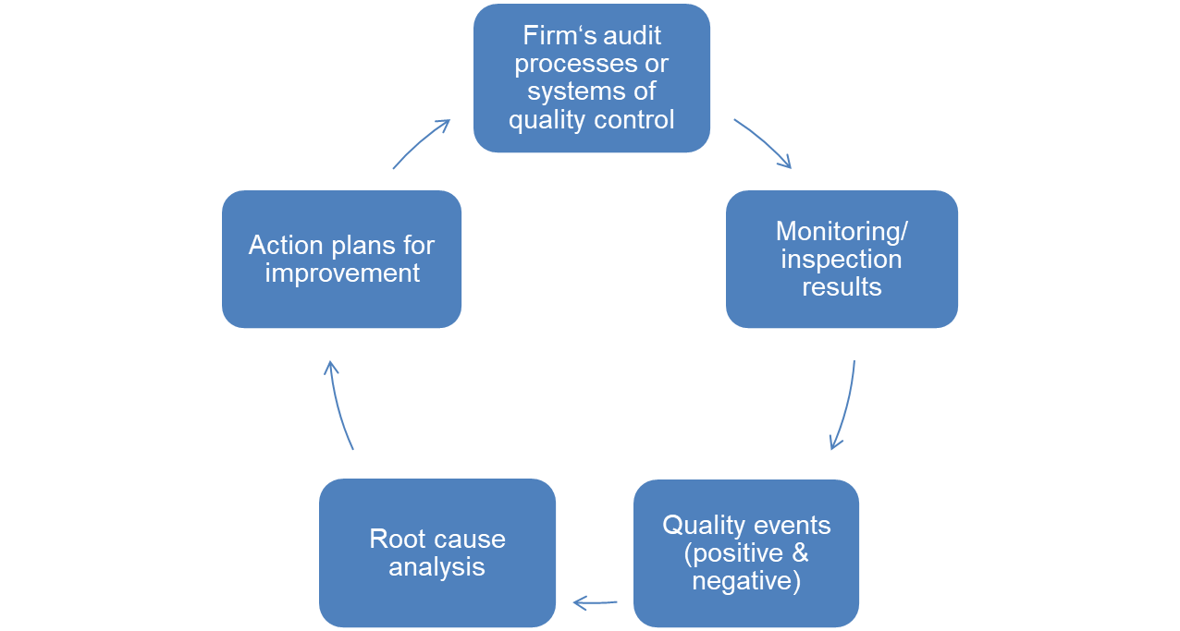
RCA Introduction & Background (cont …) Overall objective of RCA Continuous improvement of audit quality within the firm
Audit
Quality
Improvement Process

Slide 16
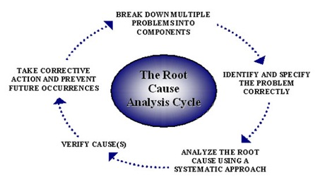
Principles of RCA
The RCA cycle

Slide 17
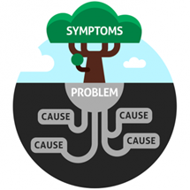

Principles of RCA (cont …)
The following are examples of possible causes, but they do NOT drill down to the true ROOT cause:
- Human error
- Misunderstood the requirement
- Misunderstood the standards
- Documentation
- System error/Audit methodology
- Elaborating on the finding
- Expanding on symptoms
- The consultant messed up
- It was an oversight
- Audit procedures/software not updated, etc.
- Should find and address the real Root Cause.
- Should, therefore, address the question:
“WHAT in the system failed to make the problem occur?”
- Until the root cause is identified, keep asking: WHY?

Slide 18
Principles of RCA (cont …)
Why do we have poor root cause analyses?
- We have not set criteria about what makes an acceptable corrective action plan (firms to implement RCA and RAP Policies and Procedures).
- We continue to accept bad answers.
- People (internal and external) do not have the Root Cause Analysis culture; don’t know any process or are not effectively trained.
- We are addressing the symptoms and not the true root of the issue.
Steps that can address poor RCA (DMAGIC):
Define the problem.
Map the process and collect data.
Analyse data and identify causes.
Gather information and evidence (asking why) until the true root cause is clear.
Implement an action plan to address the root cause(s).
Control and monitor the plan.

Slide 19
Principles of RCA (cont …)
Using the 5 Cs
1) Criteria:
The law, regulation, contractual obligation, policy, procedure or best practice that is expected to be followed.
2) Condition:
The factual analysis of the process as it exists.
3) Consequence/Effect:
Why the issue is important and noteworthy from a compliance, financial, or operational standpoint.
4) Cause:
The root cause that allowed the condition to not emulate the criteria.
5) Corrective Action/Recommendation:
Change that will address the root cause – action plan.

Slide 20
Principles of RCA (cont …)
It is important to get your mind into an investigative mode (refer to principle of professional scepticism).
Investigating checklist example:
Identify the procedure owner and those involved.
Gather information:
  - Data
  - Employee Input
  - Flowcharts of the process
  - Procedures
  - Records (quantitative data)
Has the problem occurred in the past?
Identify the root cause.
Rules of the investigation:
Use proven root cause analysis tools.
Think “out of the box”.
Brainstorm.
Take the time needed.
Put a plan together.
Professional
Scepticism &
Professional Judgement

Slide 21
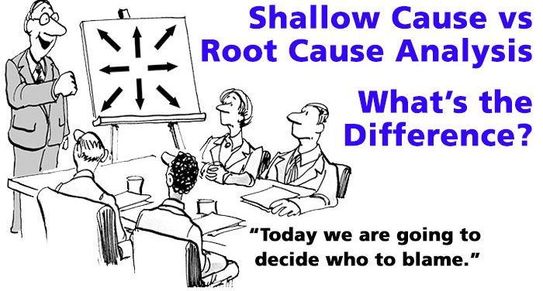
Principles of RCA (cont …)
RCA techniques:
The 5 WHYs (today’s focus).
Failure mode and effects analysis.
Flowcharting of the process flow, system flow and data flow.
Fishbone diagrams.

Slide 22
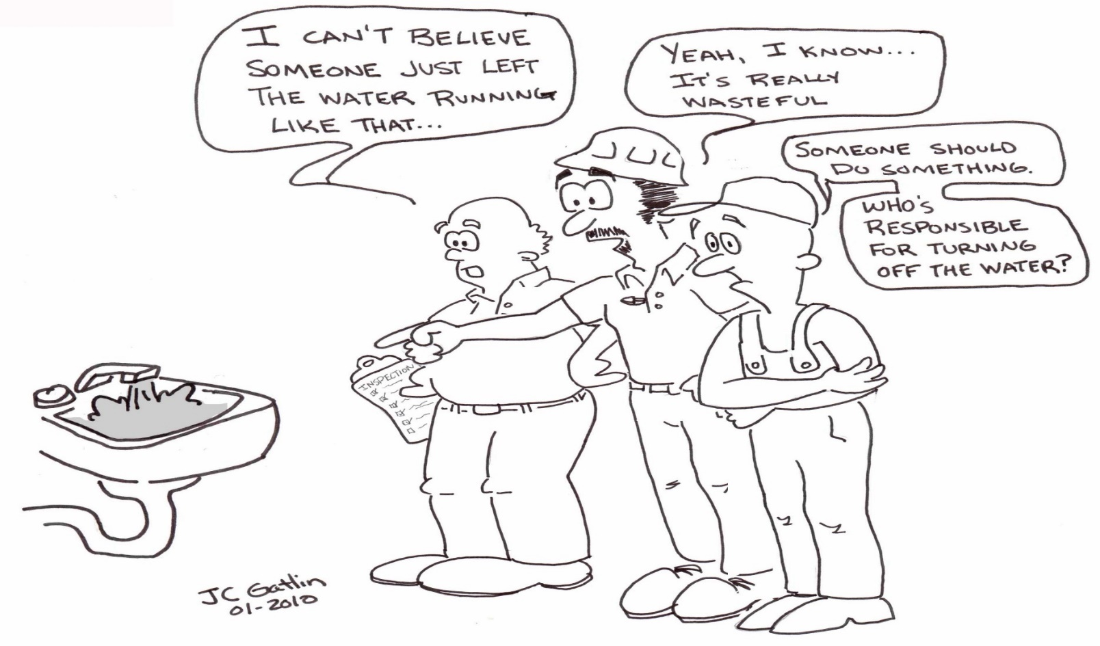
Principles of RCA (cont …)
The objective is to learn, train and improve.
NB! Take responsibility, accountability and action.

Slide 23

Principles of RCA (cont …)
The 5 WHYs explained …

Slide 24
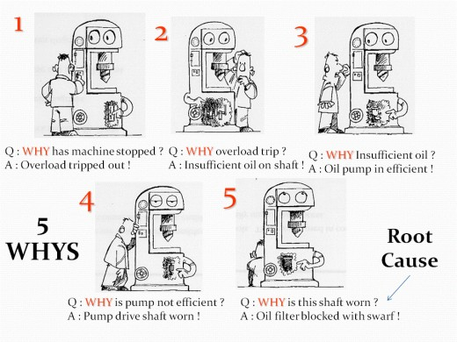
Principles of RCA (cont …)
Real life examples…

Slide 25
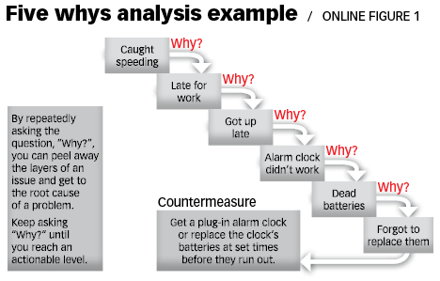
Principles of RCA (cont …)

Slide 26
Principles of RCA (cont …)
Example of 5 WHYs in action (audit)
Finding: Insufficient audit work performed in relation to a significant audit risk
First why | The audit staff member performing the work did not adequately understand what needed to be done to address the audit risks.
Second why | The audit manager was not briefed by the audit partner and so could not adequately brief those performing the work.
Third why | The audit partner did not adequately brief the staff member on the audit strategy.
Fourth why | The audit partner was not around at the planning stage of the audit.
Fifth why | The audit partner had other commitments and therefore wasn’t able to be around to brief the audit team.

Slide 27
Principles of RCA (cont …)
Example of 5 WHYs in action (audit)
Finding: Failure to identify cash flow statement misclassification
First why | The audit staff member performing the work did not practice due care or there was a lack of understanding of the subject matter.
Second why | There was a lack of direction/supervision/motivation or late/inadequate documentation because of time pressure.
Third why | Fee pressure/resource shortage or poor project management.
Fourth why | Inexperienced senior manager.
Fifth why | The audit partner did not provide training/guidance and did not apply his time to supervise the manager.

Slide 28
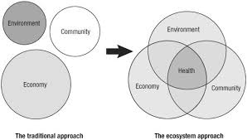
Principles of RCA (cont …)
Keep environmental matters in mind (most root causes can be traced back to decisions, actions or inactions by one or more engagement team members):
Leadership and culture
Competency of personnel
Hiring qualified personnel
Lack of or insufficient training
Adequacy of technology or tools
Departmental morale
Resources (budget/personnel)
Decision-making authority

Slide 29

Principles of RCA (cont …)
Root cause examples
Resource issues:
• Competency of staff (can impact personal, ethical and attitude issues).
• Experience of staff.
• Engagement team dynamics (e.g. incompatible combinations, skills or experience gaps, lack of continuity or over-familiarity).
• Time available (rushed jobs are rarely successful).
• Number of staff available (understaffed jobs are rarely successful).
• Lack of clarity on competencies and responsibilities.

Slide 30

Principles of RCA (cont …)
Personal, Ethical and Attitude issues
• A mindset that is prepared to cut corners (perhaps due to complacency or a desire to keep to original timetables and budgets).
• Unwillingness to acknowledge or learn from mistakes.
• Being unwilling or unable to direct, supervise or review effectively, even when resources are available and procedures require this.

Slide 31
Principles of RCA (cont …)
People
Policy
Process issues
• Issues arising from the firm’s policies and procedures – are they well framed; are there gaps; are they well understood and complied with?
• Does on-the-job mentoring and reviewing happen in the way they should?
• Does the staff appraisal system drive improvement or is it cosmetic?
• Failure to consult when appropriate.
• Poor project management, incl. leaving issues to the end of the audit.

Slide 32
Principles of RCA (cont …)
Tone @ the Top !
Leadership issues
Do staff receive appropriate leadership?
Is change effected when required?
Is leadership cosmetic or real? (Do actions belie words?)
Client issues
Can the firm be fairly expected to serve its client base? (Consider: competence, resources and specialities.)
Are review findings rooted in difficulties with client interaction? For example, fee pressure, an unreasonable client-imposed deadline to complete the audit, poor quality or information arriving late from the client.

Slide 33
Principles of RCA (cont …)
Link to ISQC 1 Para. 26: “The firm shall establish policies and procedures for the acceptance and continuance of client relationships and specific engagements, designed to provide the firm with reasonable assurance that it will only undertake or continue relationships and engagements where the firm:
(a) Is competent to perform the engagement and has the capabilities, including time and resources, to do so; (Ref: Para. A18, A23)
(b) Can comply with relevant ethical requirements; and
(c) Has considered the integrity of the client, and does not have information that would lead it to conclude that the client lacks integrity. (Ref: Para. A19-A20, A23)”
•
Is the client always right?

Slide 34

Principles of RCA (cont …)
Remedial Action Plan (RAP) examples
When root causes are identified correctly, it is easy
to develop and implement an action
plan as follows:
Reviewing of resourcing.
Improving the project management.
Increased focus on joiners or leavers.
Coaching and guidance on related initiatives.
Improving the integration of internal experts.
Real-time monitoring/support teams.
Methodology enhancements.
Guidance and communications.
Training (technical and soft skills).
Supervision and review.
Software, procedures and technical updates.

Slide 35
Questions?

Slide 36
Case Studies
Presented by
Imre Nagy – Director Inspections
Please refer to separate slides

Slide 37
Contact us:
Pieter Cloete SM Remedial Action IRBA pcloete@irba.co.za +27 87 940 8794

